Slide 1
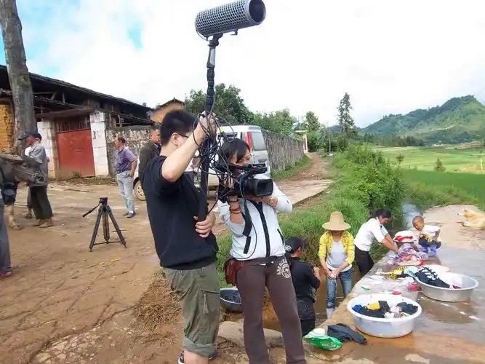

Exploring Racial Identity through Documentary Films
- an analysis based on Indigenous Australians
By Jialing Zhang

Slide 2
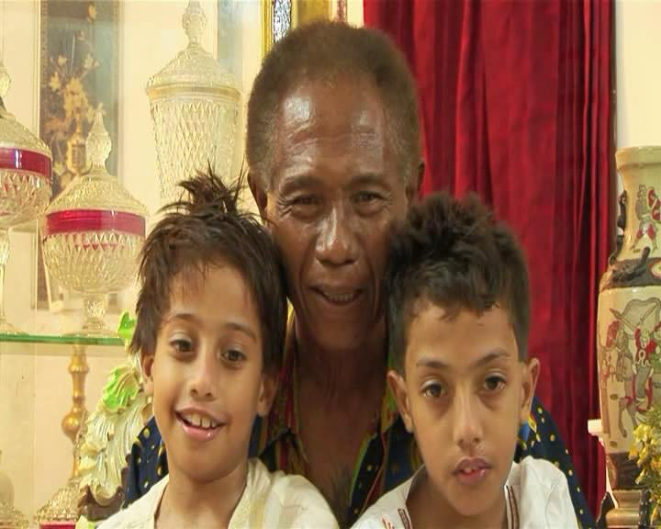
Problem Statement
Race and social issues are still hotly debated in the society (Cornell, S., & Hartmann, D.，2006).
documentary - an important carrier for xexploringhe issues of race and identity.
Indigenous Australians' existence represents the preservation and inheritance of culture (Dudgeon&Walker, 2010a).
More and more indigenous filmmakers are using documentaries to represent their race (Debenham，2013).
This research aims to analyze the manifestations, causes, and effects of race and identity of Indigenous Australians through documentary films, explore the role of media in shaping and disseminating racial identity, and how to promote inter-racial understanding and harmony through media.
Research Questions
(1) How does the documentary present the racial identity of Indigenous Australians?
(2) How does the role of documentary play in shaping and disseminating Indigenous Australian ethnic identity?

Slide 3
Significance of Research
Literature Review
It deepens understanding of how documentaries shape Indigenous Australians' racial identity. By analyzing films and audience feedback, it reveals media's power in influencing perceptions. This knowledge can guide better media practices to foster inter - racial harmony and respect.
It offers insights into promoting inter - racial understanding. Understanding how documentaries present and spread Indigenous Australian identity helps create more inclusive media content. This can bridge racial gaps and contribute to a more harmonious multi - racial society.
Al-Bahadly & Green (2015) and Liss (2018)：
By studying a large number of documentary films, they found that different racial images also made the public's attitudes towards them different.
Conclusions: First, when they used camera technology to present black people as criminals, the audience had a more negative impression of them;
Secondly, diverse and complex narrative styles promote tolerance and understanding of different races.
Harris (2017)：
explored the changing attitudes of 13 toward African American and white audiences
Conclusions: more white people are willing to get along with black people after watching documentaries that show the positive aspects of black people.
Bierwiaczonek et al (2020)：
conducted related research and proposed that by watching racial documentaries with different histories and styles,
Conclusions: audiences' sensitivity to culture is greatly increased, and discrimination in cross-cultural communication is also reduced.

Slide 4
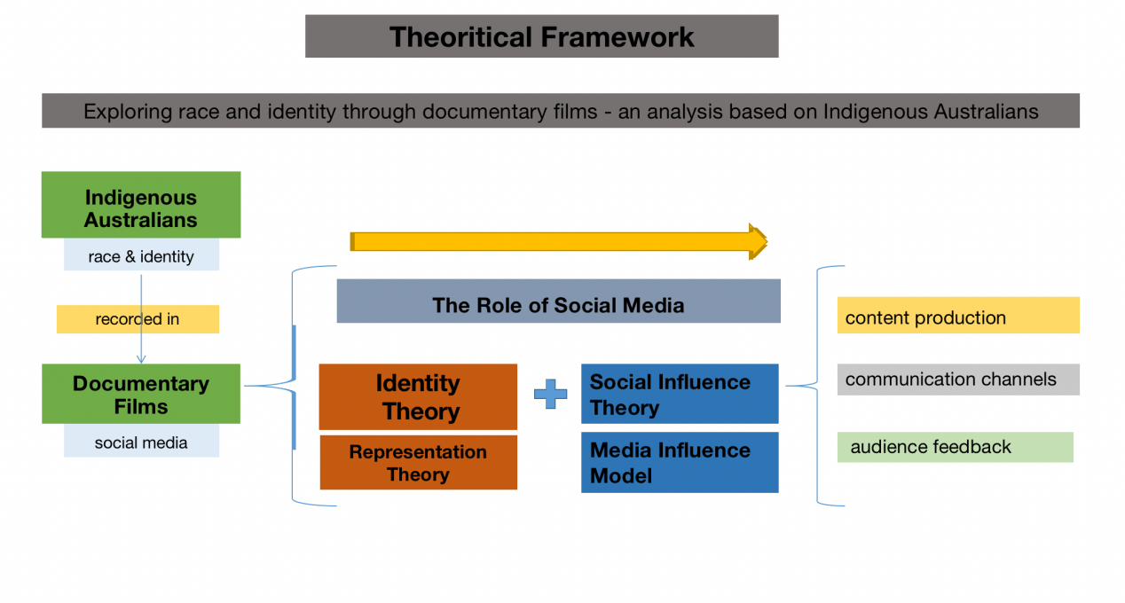
Theoritical Framework
Methodology
Mixed research method
1, Qualitative Research of Documentary Content and Communication Channels
in-depth analysis of the slected documentaries - how documentaries present the identity and racial characteristics of Australian Aborigines.
A, Content analysis: Analysis of themes, cultural symbols, historical references and expressions of identity in documentaries to understand the presentation of racial issues.
B, Visual analysis: Examine visual elements such as photography, color layout, and visual metaphors to assess how aesthetic choices affect viewers' emotional and psychological responses.
2, Quantitative Research of Documentary Audience Feedback
further explore audience perceptions and attitudes towards Aboriginal identity and race in Australia by collecting and analyzing audience feedback on the documentary.
audience selection： target audience group: may include documentary viewers, social media users, film critics, etc.,
feedback collection: audience's comments opinions, eactions
feedback analysis： a quantitative analysis

